Slide 1
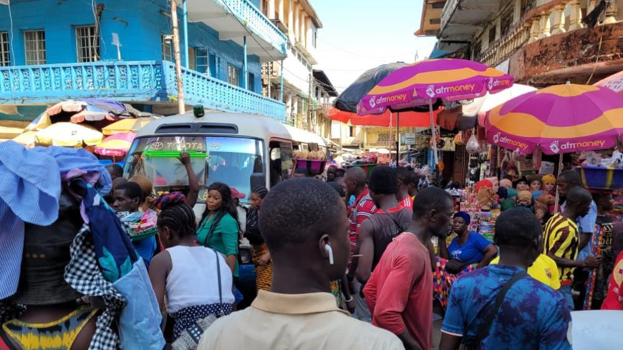

An introduction to TRANSITIONS and the Routemap
E-learning course and guide to the Routemap knowledge resource

Slide 2
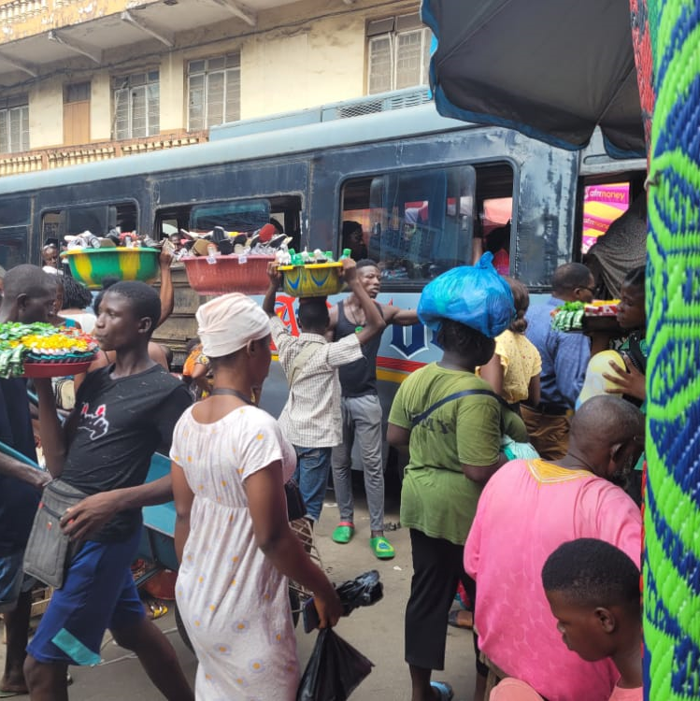
Welcome!
Thanks for your interest in the Informal Public Transport Routemap, produced by the High Volume Transport (HVT) TRANSITIONS project (funded by UKAID).
In this introductory short course we respond to the following questions:
What is ‘Informal Public Transport’? And why do we think it is so important?
What were the aims and activities of the TRANSITIONS project?
How should I use the online knowledge resource and TRANSITIONS Routemap?
Notes:
Introduce - Welcome the opportunity to provide an introduction to the TRANSITIONS project, which focuses on the role and future possibilities of ‘informal public transport’
Despite the prominent role of Informal Public Transport and benefits provided (mobility, employment), relatively limited attention given to how the sector can be supported
Acknowledge problems – but what are the best ways in which the ‘informal public sector’ can be better supported to professionalise and provide clean, affordable and safe mobility services.
Term informal transport covers many modes.
TRANSITIONS focuses Informal Public Transport (IPT) - services with larger vehicles (minibuses and sedans) operating along routes, rather than three-wheelers and two-wheelers where passenger determines destination.
Photos show informal transport in Freetown, Sierra Leone

Slide 3
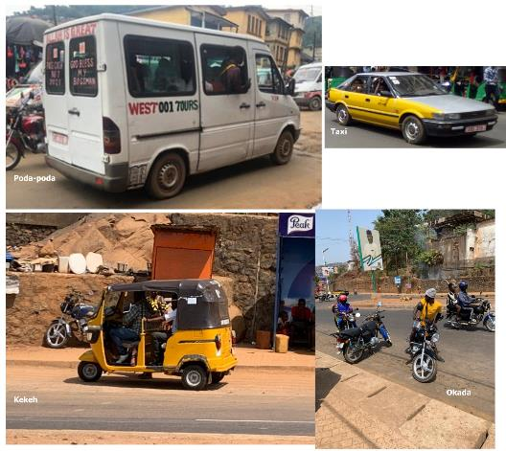
1.1 What is ‘informal transport’?
‘Informal transport’ is an umbrella term, used to refer to a wide range of privately-operated mobility services in Low and Middle Income Countries (LMICs). These take many different forms, utilising motorcycles, three-wheelers, cars and buses.
The images on the left show ‘Okada’ motorcycle taxis, a ‘Kekeh’ three-wheeler, a ‘Taxi’ car and a ‘Poda-poda’ minibus service, all of which operate in Freetown, Sierra Leone.
Terminology used to describe ‘informal transport’ has been the subject of considerable debate, with alternatives such as ‘intermediate transport’, ‘paratransit’, ‘popular transport’, ‘shared transport’ and ‘artisanal’ (in francophone Africa) being proposed.
Taxi
Poda-poda
Keh-keh
Okada
Notes:
Introduce - Welcome the opportunity to provide an introduction to the TRANSITIONS project, which focuses on the role and future possibilities of ‘informal public transport’
Despite the prominent role of Informal Public Transport and benefits provided (mobility, employment), relatively limited attention given to how the sector can be supported
Acknowledge problems – but what are the best ways in which the ‘informal public sector’ can be better supported to professionalise and provide clean, affordable and safe mobility services.
Term informal transport covers many modes.
TRANSITIONS focuses Informal Public Transport (IPT) - services with larger vehicles (minibuses and sedans) operating along routes, rather than three-wheelers and two-wheelers where passenger determines destination.
Photos show informal transport in Freetown, Sierra Leone

Slide 4
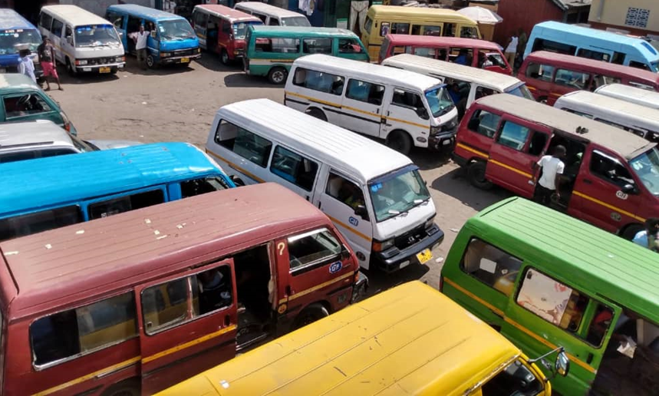
1.2 What is Informal Public Transport (IPT)?
Case city | IPT services
Accra, Ghana | Trotro
Kumasi, Ghana
Freetown, Sierra Leone | Poda-poda
Cape Town, South Africa | Minibus-Taxi
Maputo, Mozabique | Chapa and MyLove
For the TRANSITIONS project, the decision was taken to focus on services that are typically provided by midi- and mini-buses, and occasionally by sedan vehicles. These larger vehicles are generally shared by multiple passengers along set routes and are, therefore, more similar to formal public transport.
For consistency, we refer to these services as Informal Public Transport (IPT), while recognising that there are instances where the services in question are not strictly ‘informal’ – i.e. in the sense that they are subject to government operating regulations and taxation policies. See IPT regulation & enforcement for further information.
In contrast to taxi services (typically provided using motorcycles, three-wheelers and cars), where the passenger is able to determine the route, IPT has greater potential to deliver efficient, low carbon, mass transit. This brings us on to discuss why we think that working with the IPT sector is so important.
Notes:
Introduce - Welcome the opportunity to provide an introduction to the TRANSITIONS project, which focuses on the role and future possibilities of ‘informal public transport’
Despite the prominent role of Informal Public Transport and benefits provided (mobility, employment), relatively limited attention given to how the sector can be supported
Acknowledge problems – but what are the best ways in which the ‘informal public sector’ can be better supported to professionalise and provide clean, affordable and safe mobility services.
Term informal transport covers many modes.
TRANSITIONS focuses Informal Public Transport (IPT) - services with larger vehicles (minibuses and sedans) operating along routes, rather than three-wheelers and two-wheelers where passenger determines destination.
Photos show informal transport in Freetown, Sierra Leone

Slide 5
1.3 Why is it so important to work with IPT providers?
IPT already plays a fundamental role in providing mass transit in the cities and metropolitan areas of Sub-Saharan Africa. Taking into account that Africa’s urban population is expected to nearly triple by 2050, pragmatic solutions need to be found for delivering low carbon, affordable and safe mobility. While major, formal public transport schemes, such as Bus Rapid Transit (BRT) can play a role, these take a substantial number of years to implement and serve only a fraction of the metropolitan area. A concerted effort is therefore required to understand how stakeholders can best work together to improve and maximise the benefits of the existing IPT services, while also seeking to minimise negative aspects.
IPT benefits – IPT service providers, which include those formed into route and area-based associations, as well as illegal ‘floaters’ and ‘pirates’, have developed extensive networks. It is estimated, for example, that there are more than 1,800 routes served across the five TRANSITIONS project cities of Accra, Kumasi, Freetown, Cape Town and Maputo. Millions of households rely on these transport operations, which are currently achieved free of subsidisation by public authorities. The sector also provides employment for thousands of drivers, ‘mates’ (fare collectors) and others assisting at IPT terminals and stops.
IPT problems – There are, nevertheless, substantial problems to be overcome. These include: over-supply of IPT on the most lucrative routes, resulting in congestion and unsafe driving as vehicles compete to pick-up passengers; poor fuel efficiency and high emissions of pollutants by old and poorly maintained vehicles, together with associated safety problems; and exploitative labour conditions for those employed in the sector.
The following table summarises the pros and cons of IPT, as well as opportunities in relation to policy objectives:
Notes:
Introduce - Welcome the opportunity to provide an introduction to the TRANSITIONS project, which focuses on the role and future possibilities of ‘informal public transport’
Despite the prominent role of Informal Public Transport and benefits provided (mobility, employment), relatively limited attention given to how the sector can be supported
Acknowledge problems – but what are the best ways in which the ‘informal public sector’ can be better supported to professionalise and provide clean, affordable and safe mobility services.
Term informal transport covers many modes.
TRANSITIONS focuses Informal Public Transport (IPT) - services with larger vehicles (minibuses and sedans) operating along routes, rather than three-wheelers and two-wheelers where passenger determines destination.
Photos show informal transport in Freetown, Sierra Leone

Slide 6
1.4 Summarizing the pros, cons and opportunities presented by IPT
Policy objective | Cons & externalities | Pros & opportunities
Mobility provision | - | IPT accounts for largest share of motorised mobility in the cities of Sub-Saharan Africa.
Affordable mobility | Although relatively low cost, IPT is still expensive for low income groups (significant portion of monthly income). | IPT currently taxed/charged rather than subsidised. Review of fare setting and financial support opportunities should be undertaken.
Employment | Employment within sector can be fragile and exploitative, even while providing crucial jobs. | Existing IPT unions can be supported in their work to provide fare salaries, health insurance and planning for old age.
Operational efficiency | On-street competition leads to congestion and road safety problems. | IPT far better than current alternatives (e.g. motorcycle taxis) and high potential for improvement through basic regulation and enforcement.
Low carbon emissions & air quality | Old and poorly maintained vehicles have low fuel efficiency and are highly polluting, contributing to local air quality and health concerns. | Improved maintenance regimes could achieve significant short-term benefits, with potential for fleet renewal and alternative fuels in the medium and long-term.
Inclusive | Passengers have limited choice and can be ‘pushed’ to board certain vehicles. Sexual harassment is known to occur. | IPT crews receive limited or no training and professionalisation of the sector could assist. IPT provides mobility with goods for traders and fleet renewal could improve opportunities for mobility impaired people.
Safety | Old, sometimes retrofitted vehicles, combined with poor driving, result in unsafe conditions. | Improved salary conditions and regulation of competition, plus fleet renewal, could achieve significant improvements.
Notes:
Introduce - Welcome the opportunity to provide an introduction to the TRANSITIONS project, which focuses on the role and future possibilities of ‘informal public transport’
Despite the prominent role of Informal Public Transport and benefits provided (mobility, employment), relatively limited attention given to how the sector can be supported
Acknowledge problems – but what are the best ways in which the ‘informal public sector’ can be better supported to professionalise and provide clean, affordable and safe mobility services.
Term informal transport covers many modes.
TRANSITIONS focuses Informal Public Transport (IPT) - services with larger vehicles (minibuses and sedans) operating along routes, rather than three-wheelers and two-wheelers where passenger determines destination.
Photos show informal transport in Freetown, Sierra Leone

Slide 7
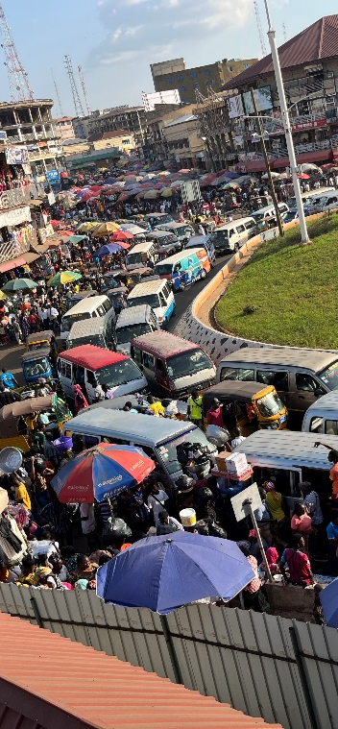
2.1 What were the aims and structure of the TRANSITIONS project?
The TRANSITIONS project commenced with this understanding that IPT is the true, collective form of transit meeting daily needs in Sub-Saharan African cities, and that despite this, it remains an under-researched topic area. Project partners therefore set out to better understand how we can enable a transition towards a clean (low carbon), affordable, efficient and safe transport network involving IPT as an integral element.
The consortium is made up of research coordination and advisory partners Transitec, University of Cape Town and Vectos (part of SLR Consulting); together with partners that led research in specific cities – Kwame Nkrumah University of Science & Technology (KNUST), Mozambique Mobility Observatory and Sierra Leone Urban Research Centre.
Structured as an applied research project, work was undertaken in three phases:
Phase 1 – A ‘state of knowledge’ literature review
Phase 2 – Primary research in the five case cities: Accra, Freetown, Kumasi, Cape Town and Maputo
Phase 3 – Development of the TRANSITIONS Routemap and cross-city comparison
Main aspects of these project phases are summarised in the following slides.
Notes:
Introduce - Welcome the opportunity to provide an introduction to the TRANSITIONS project, which focuses on the role and future possibilities of ‘informal public transport’
Despite the prominent role of Informal Public Transport and benefits provided (mobility, employment), relatively limited attention given to how the sector can be supported
Acknowledge problems – but what are the best ways in which the ‘informal public sector’ can be better supported to professionalise and provide clean, affordable and safe mobility services.
Term informal transport covers many modes.
TRANSITIONS focuses Informal Public Transport (IPT) - services with larger vehicles (minibuses and sedans) operating along routes, rather than three-wheelers and two-wheelers where passenger determines destination.
Photos show informal transport in Freetown, Sierra Leone

Slide 8
2.2 A ‘state of knowledge’ literature review
Former literature reviews that cover, at least in part, the scope the TRANSITIONS project have included:
Overview of public transport in Sub-Saharan Africa (Trans-Africa Consortium 2008); and
Mobility and access in Sub-Saharan Africa cities: The state of knowledge and research environments (Behrens et al. 2015)
Alongside these, the topic has been covered in global reviews of informal transport literature, but it was considered that an update was warranted. This view was validated by the results, which showed that interest in this topic, and numbers of research and other publications, have surged over the last ten years.
Number of informal transport publications per year (reviewed for TRANSITIONS)
Notes:
Introduce - Welcome the opportunity to provide an introduction to the TRANSITIONS project, which focuses on the role and future possibilities of ‘informal public transport’
Despite the prominent role of Informal Public Transport and benefits provided (mobility, employment), relatively limited attention given to how the sector can be supported
Acknowledge problems – but what are the best ways in which the ‘informal public sector’ can be better supported to professionalise and provide clean, affordable and safe mobility services.
Term informal transport covers many modes.
TRANSITIONS focuses Informal Public Transport (IPT) - services with larger vehicles (minibuses and sedans) operating along routes, rather than three-wheelers and two-wheelers where passenger determines destination.
Photos show informal transport in Freetown, Sierra Leone

Slide 9
2.3 A ‘state of knowledge’ literature review
The literature review was based on nine thematic searches (that yielded 322 publications) and six case city searches (yielding 128 publications). Alongside the five TRANSITIONS case cities referred to previously, the city of Harare was also covered by the literature review.
As shown in the figures, topics such as ‘regulatory frameworks’ and IPT ‘operating practices’ have received relatively more attention, in comparison to the themes of ‘environmental externalities’ and ‘gender and inclusion’. Research activities tend also to have focussed around certain cities, including Cape Town, Nairobi and Accra.
Number of publications
The full literature review ‘Compendium Report’, that includes a summary of findings by topic, can be downloaded from the HVT website.
Publication research themes (%)
Geographic focus of research
Notes:
Introduce - Welcome the opportunity to provide an introduction to the TRANSITIONS project, which focuses on the role and future possibilities of ‘informal public transport’
Despite the prominent role of Informal Public Transport and benefits provided (mobility, employment), relatively limited attention given to how the sector can be supported
Acknowledge problems – but what are the best ways in which the ‘informal public sector’ can be better supported to professionalise and provide clean, affordable and safe mobility services.
Term informal transport covers many modes.
TRANSITIONS focuses Informal Public Transport (IPT) - services with larger vehicles (minibuses and sedans) operating along routes, rather than three-wheelers and two-wheelers where passenger determines destination.
Photos show informal transport in Freetown, Sierra Leone

Slide 10
2.4 Research activities in the TRANSITIONS case cities
Case city | Terminals
Accra, Ghana | Kinbu and ‘37’ Terminal
Kumasi, Ghana | Tech Junction and Sofoline Terminal
Freetown, Sierra Leone | Eastern Police and Regent Road
Cape Town, South Africa | Khayelitscha Site C and Khayelitscha Mall
Maputo, Mozabique | Ximpeto and Combatentes
Findings from the Phase 1 literature review informed the planning of the Phase 2 primary research activities to be undertaken in the five case cities: Accra, Kumasi and Freetown, forming a western Africa cluster; and Cape Town and Maputo, forming a southern Africa cluster. For each city it was planned that research should be undertaken in cooperation with two IPT associations or unions, based around two IPT terminals and routes. The table below confirms the terminals that provided the focal point for research in each city.
Notes:
Introduce - Welcome the opportunity to provide an introduction to the TRANSITIONS project, which focuses on the role and future possibilities of ‘informal public transport’
Despite the prominent role of Informal Public Transport and benefits provided (mobility, employment), relatively limited attention given to how the sector can be supported
Acknowledge problems – but what are the best ways in which the ‘informal public sector’ can be better supported to professionalise and provide clean, affordable and safe mobility services.
Term informal transport covers many modes.
TRANSITIONS focuses Informal Public Transport (IPT) - services with larger vehicles (minibuses and sedans) operating along routes, rather than three-wheelers and two-wheelers where passenger determines destination.
Photos show informal transport in Freetown, Sierra Leone

Slide 11
2.5 Research activities in the TRANSITIONS case cities
Research methodologies were selected in order to address the project themes of clean (low carbon), affordable, safe and efficient (operationally efficient) IPT. As summarised also in the diagram, the three main activities were:
Stakeholder interviews with public authority and IPT industry stakeholders, to understand the regulatory, organisational and business models that apply, as well as their effectiveness and implications for operational efficiency and safety.
Passenger opinion surveys, providing information on IPT customer profiles and perceptions of service affordability, safety and priorities for improvement.
Fuel consumption and GPS tracking survey, to gather evidence of typical fuel consumption of IPT vehicles and related insights on carbon emissions, localised air pollution and impacts for operational business models.
Research outputs
Clean
(low carbon)
Typical fuel consumption
Affordable
Fare satisfaction levels
Priorities for improvement
Safe
Vehicle types & ages
Experience of women
Efficient
(operational)
Regulatory framework and enforcement
Estimated emissions
Information on maintenance practices
Experience of women
Needs of specific user groups
Implications of operational practices
Organisational and operational models and remuneration of staff
Notes:
Introduce - Welcome the opportunity to provide an introduction to the TRANSITIONS project, which focuses on the role and future possibilities of ‘informal public transport’
Despite the prominent role of Informal Public Transport and benefits provided (mobility, employment), relatively limited attention given to how the sector can be supported
Acknowledge problems – but what are the best ways in which the ‘informal public sector’ can be better supported to professionalise and provide clean, affordable and safe mobility services.
Term informal transport covers many modes.
TRANSITIONS focuses Informal Public Transport (IPT) - services with larger vehicles (minibuses and sedans) operating along routes, rather than three-wheelers and two-wheelers where passenger determines destination.
Photos show informal transport in Freetown, Sierra Leone

Slide 12
3.1 Developing and applying the TRANSITIONS Routemap
Based on the enhanced understanding of the IPT sector following the Phase 2 research activities, the final project phase has involved the development of the TRANSITIONS Routemap. To further inform this process, representatives of public authorities and IPT unions and associations from the TRANSITIONS case cities, as well as seven additional guest cities, participated in two regional workshops in Africa (hosted in Accra and Cape Town). These enabled sharing of the results of the TRANSITIONS research, as well as productive discussions around the challenges experienced by practitioners, as well as opportunities and potential solutions.
As the principal output of the project, the TRANSITIONS Routemap and online knowledge resource provides:
A proposed ‘route’ towards improved IPT services, comprising a sequence of stages that could provide the basis for a smaller pilot project or larger, cost-effective programme for affordable, collective mobility.
A series of self-appraisal questions, that will assist practitioners in understanding the current situation in their city and degree of preparedness to move forward through the steps of the Routemap.
Bckground knowledge on key themes relating to IPT, combined with comparative analysis of the situation in the TRANSITIONS case cities: Accra, Cape Town, Freetown, Kumasi and Maputo.
Main messages resulting from the research for practitioners and the international community.
Signposting to other useful resources that provide further information and guidance on important themes.
Notes:
Introduce - Welcome the opportunity to provide an introduction to the TRANSITIONS project, which focuses on the role and future possibilities of ‘informal public transport’
Despite the prominent role of Informal Public Transport and benefits provided (mobility, employment), relatively limited attention given to how the sector can be supported
Acknowledge problems – but what are the best ways in which the ‘informal public sector’ can be better supported to professionalise and provide clean, affordable and safe mobility services.
Term informal transport covers many modes.
TRANSITIONS focuses Informal Public Transport (IPT) - services with larger vehicles (minibuses and sedans) operating along routes, rather than three-wheelers and two-wheelers where passenger determines destination.
Photos show informal transport in Freetown, Sierra Leone

Slide 13
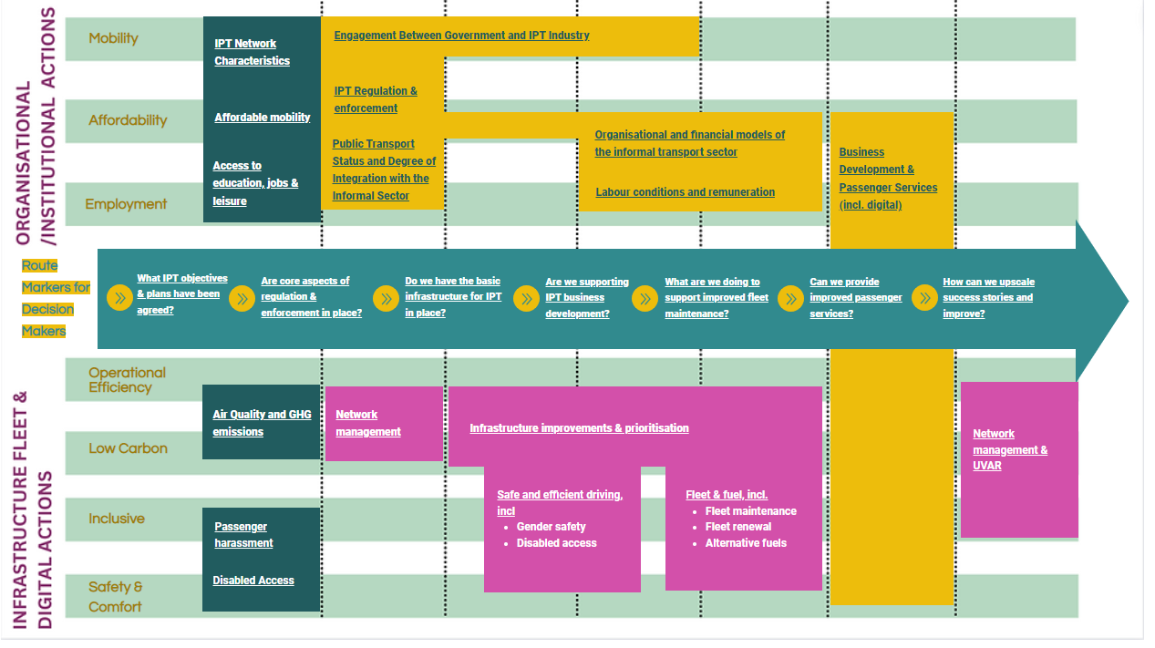
3.2 Navigating the TRANSITIONS Routemap online resource
TRANSITIONS Routemap Key Diagram
The Routemap Key Diagram on the website homepage provides an overview of the ‘route markers’, as well as an index to navigate to further information on IPT topics and actions.
In the following slides we explain the different components of the diagram.
Notes:
Introduce - Welcome the opportunity to provide an introduction to the TRANSITIONS project, which focuses on the role and future possibilities of ‘informal public transport’
Despite the prominent role of Informal Public Transport and benefits provided (mobility, employment), relatively limited attention given to how the sector can be supported
Acknowledge problems – but what are the best ways in which the ‘informal public sector’ can be better supported to professionalise and provide clean, affordable and safe mobility services.
Term informal transport covers many modes.
TRANSITIONS focuses Informal Public Transport (IPT) - services with larger vehicles (minibuses and sedans) operating along routes, rather than three-wheelers and two-wheelers where passenger determines destination.
Photos show informal transport in Freetown, Sierra Leone

Slide 14
3.3 Navigating the Routemap: Policy objectives and evidence
When preparing a Sustainable Urban Mobility Plan (SUMP) or project involving IPT, relevant policy objectives would be expected to include:
mobility,
affordability (of transport),
employment generation,
operational efficiency,
low carbon emissions,
inclusivity,
as well as safety and comfort.
Use this element of the Key Diagram (or the ‘Context and Evidence’ sub-menu), to access background information and evidence gathered through the TRANSITIONS research in relation to these themes.
Policy objectives & evidence
Organisational and
institutional characteristics
A route to low carbon, affordable and safe IPT
Infrastructure, fleet & digital actions
Notes:
Introduce - Welcome the opportunity to provide an introduction to the TRANSITIONS project, which focuses on the role and future possibilities of ‘informal public transport’
Despite the prominent role of Informal Public Transport and benefits provided (mobility, employment), relatively limited attention given to how the sector can be supported
Acknowledge problems – but what are the best ways in which the ‘informal public sector’ can be better supported to professionalise and provide clean, affordable and safe mobility services.
Term informal transport covers many modes.
TRANSITIONS focuses Informal Public Transport (IPT) - services with larger vehicles (minibuses and sedans) operating along routes, rather than three-wheelers and two-wheelers where passenger determines destination.
Photos show informal transport in Freetown, Sierra Leone

Slide 15
3.4 Navigating the Routemap: the Routemarkers
The central arrow or spine of the Routemap Key Diagram shows the main stages of an approach to working collaboratively with the IPT sector. The individual stages, referred to as ‘route markers’ are posed as questions:
What IPT objectives and plans have been agreed?
Are core aspects of regulation and enforcement in place?
Do we have the basic infrastructure for IPT in place?
Are we supporting IPT business development?
What are we doing to support improved fleet maintenance?
Can we provide improved passenger services?
How can we upscale success stories and improve?
Route Marker descriptions and related city self-appraisal questions can be access from the ‘Routemap & City Self-Appraisal’ menu.
Policy objectives & evidence
Organisational and
institutional characteristics
A route to low carbon, affordable and safe IPT
Infrastructure, fleet & digital actions
Notes:
Introduce - Welcome the opportunity to provide an introduction to the TRANSITIONS project, which focuses on the role and future possibilities of ‘informal public transport’
Despite the prominent role of Informal Public Transport and benefits provided (mobility, employment), relatively limited attention given to how the sector can be supported
Acknowledge problems – but what are the best ways in which the ‘informal public sector’ can be better supported to professionalise and provide clean, affordable and safe mobility services.
Term informal transport covers many modes.
TRANSITIONS focuses Informal Public Transport (IPT) - services with larger vehicles (minibuses and sedans) operating along routes, rather than three-wheelers and two-wheelers where passenger determines destination.
Photos show informal transport in Freetown, Sierra Leone

Slide 16
3.3 Navigating the Routemap: IPT organizational characteristics
Policy objectives & evidence
Organisational and
institutional characteristics
The organisational and institutional characteristics part of the Key Diagram guides the user towards background information and consideration of the situation in TRANSITIONS case cities, in relation to:
IPT regulation & enforcement
Integration of Public Transport and IPT
Organisational and financial models of IPT
Labour conditions
And engagement between government and the IPT industry
This information can also be accessed from the ‘IPT Organisation’ sub-menu),
A route to low carbon, affordable and safe IPT
Infrastructure, fleet & digital actions
Notes:
Introduce - Welcome the opportunity to provide an introduction to the TRANSITIONS project, which focuses on the role and future possibilities of ‘informal public transport’
Despite the prominent role of Informal Public Transport and benefits provided (mobility, employment), relatively limited attention given to how the sector can be supported
Acknowledge problems – but what are the best ways in which the ‘informal public sector’ can be better supported to professionalise and provide clean, affordable and safe mobility services.
Term informal transport covers many modes.
TRANSITIONS focuses Informal Public Transport (IPT) - services with larger vehicles (minibuses and sedans) operating along routes, rather than three-wheelers and two-wheelers where passenger determines destination.
Photos show informal transport in Freetown, Sierra Leone

Slide 17
3.3 Navigating the Routemap: Actions for improving IPT
This final part of the Routemap knowledge resource sets out five categories of actions that could be pursued in order to achieve improvements to IPT services. Although examples are limited, summary case study information is provided where possible:
Infrastructure and operations – Cape Town has introduced Minibus-Taxi lanes
Network Management– Dar es Salaam introduced restrictions on the sizes of IPT vehicles entering the city centre
Fleet and fuel – Cape Town and Dakar have implemented fleet recapitalisation and replacement schemes
Business development – The Blue Dot Taxi scheme involved partnering with the Minibus-Taxi sector in Cape Town to improve service quality and safety for passengers
Digital passenger services – from mapping of services in Accra to smart ticketing approaches in Senegal.
This information can be accessed from the ‘Actions’ sub-menu
Policy objectives & evidence
Organisational and
institutional characteristics
A route to low carbon, affordable and safe IPT
Infrastructure, fleet & digital actions
Notes:
Introduce - Welcome the opportunity to provide an introduction to the TRANSITIONS project, which focuses on the role and future possibilities of ‘informal public transport’
Despite the prominent role of Informal Public Transport and benefits provided (mobility, employment), relatively limited attention given to how the sector can be supported
Acknowledge problems – but what are the best ways in which the ‘informal public sector’ can be better supported to professionalise and provide clean, affordable and safe mobility services.
Term informal transport covers many modes.
TRANSITIONS focuses Informal Public Transport (IPT) - services with larger vehicles (minibuses and sedans) operating along routes, rather than three-wheelers and two-wheelers where passenger determines destination.
Photos show informal transport in Freetown, Sierra Leone

Slide 18
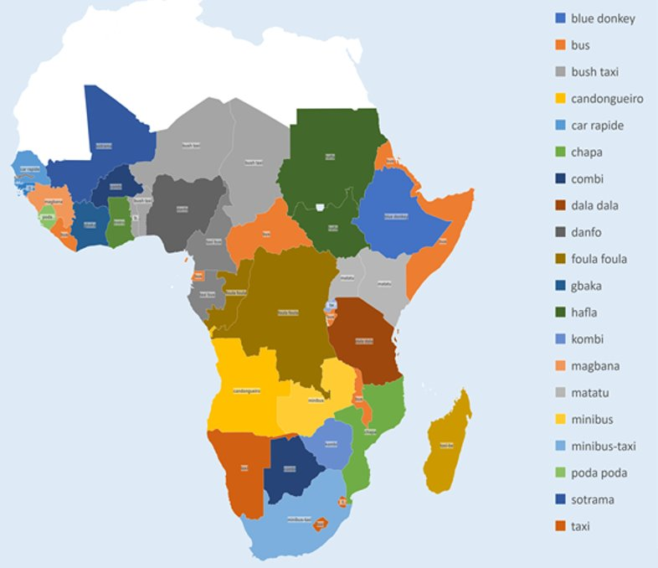
Thanks for your attention
Informal Public Transport across Sub-Saharan Africa
Thank you for taking the time to complete this introduction to the topic of IPT, the activities of the TRANSITIONS project, and the online knowledge resource. We hope that you find the background information, cross-city comparison and Routemap recommendations available on this website useful.
The outcomes of research undertaken by TRANSITIONS will be reported also in academic papers and included on our ‘Repository’ page once available.
Should you have any questions in relation to the work undertaken by the project or applying the Routemap proposals in practice then please do reach out to us.
Source: Map based upon @FUNMIOYATGUN 2018 and TRANSITIONS partners’ knowledge
Notes:
Introduce - Welcome the opportunity to provide an introduction to the TRANSITIONS project, which focuses on the role and future possibilities of ‘informal public transport’
Despite the prominent role of Informal Public Transport and benefits provided (mobility, employment), relatively limited attention given to how the sector can be supported
Acknowledge problems – but what are the best ways in which the ‘informal public sector’ can be better supported to professionalise and provide clean, affordable and safe mobility services.
Term informal transport covers many modes.
TRANSITIONS focuses Informal Public Transport (IPT) - services with larger vehicles (minibuses and sedans) operating along routes, rather than three-wheelers and two-wheelers where passenger determines destination.
Photos show informal transport in Freetown, Sierra Leone

